Slide 1
STRESS: Fat, Disease, and Diet SILVER LININGS 2011 Grand Regal Hotel, Davao City
September 17, 2011

Slide 2
Eat This, NOT That Drink This, NOT That
BROWN SUGAR?
WHITE SUGAR?

Slide 3
Eat This, NOT That Drink This, NOT That
SUGAR
White (Table Sugar)
Refined, Processed, stripped of all natural components, vitamins, water, minerals
Cal 15 /tsp Glycemic Index 65 (1-100 scale)
Brown Sugar = same as white sugar
White Sugar + Molasses
Brown sugar has just as many calories as white & gets processed by your body the same way. Molasses gives color & adds a little magnesium & calcium but not enough to make a difference
Muscovado Cane
Raw, Unrefined, lower glycemic index
B2, B3, Calcium, Iron, Magnesium, Potassium
Muscovado Coco-Sugar
Low GI = 35

Slide 4
Eat This, NOT That Drink This, NOT That

Slide 5
Eat This, NOT That Drink This, NOT That
C2 RED (apple) 500 ml
Servings/bottle = 2
(250 ml/serving)
Cal/500ml = 240
Sugar/500ml = 54g
If 1 bottle/meal x 3 meals/day x 5 days = gain 1 lb in 5 days
Or 6 lbs in 1 mo.
C2 GREEN TEA 500 ml
Servings/bottle = 2
(240 ml serving)
Cal/500ml = 90
Sugar/500ml = 20g

Slide 6
Eat This, NOT That MCDONALDS Favourites

Slide 7
Eat This, NOT That MCDONALDS Favourites
Regular Hamburger
Regular Cheeseburger
McChicken
Fillet – o - Fish
HAMBURGER
Cal = 250
Fat = 9 g
Sodium = 520 mg
CHEESEBURGER
Cal = 300
Fat = 12 g
Sodium = 750
McCHICKEN
Cal = 360
Fat = 26 g
Sodium = 980 mg
FILLET-O-FISH
Cal = 380
Fat = 16 g
Sodium = 830

Slide 8
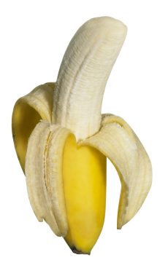
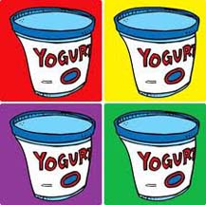
NUTRITION IQ
You need POTASSIUM to keep your metabolism fast and muscles strong.
Which of these offers the most?
One medium baked “kamote”
One cup fat-free yogurt
One medium banana

Slide 9
NUTRITION IQ
ANSWER A. “Kamote”
Sweet potato or “kamote” contains 542 mg; the yogurt has 475 and the banana 422 mg
Other potassium-rich foods to help you reach the recommended 4,700 mg/day
Tomato sauce (811)
Orange juice (496)
Melon or cantaloupe (427)

Slide 10
NUTRITION IQ
Which ground meat makes the healthiest, low-fat burger?
Ground beef
Ground turkey
Ground chicken

Slide 11
NUTRITION IQ
ANSWER: ALL OF THE ABOVE CAN
If you choose the right cut
For ground beef, look for at least 90% lean (no marbling, from sirloin) w/c is less than 10g of fat per 3.5 oz serving.
For turkey & chicken, ground BREAST is better than regular (because the high-fat skin doesn’t get processed in).

Slide 12
NUTRITION IQ
Calcium is key to building bones, but which of these dairy foods is NOT a good source?
Cottage Cheese
Yogurt smoothie
Fat-free milk

Slide 13
NUTRITION IQ
ANSWER A.
Cottage cheese is low in calories & high in protein but is NOT a good source of calcium. During processing 75% of calcium is lost.
½ cup serving = 70mg calcium, which is less than ½ what you get in the same amount of fat-free milk
Daily calcium needs =1000mg for age 50 & younger; 1200mg for 51 & older

Slide 14
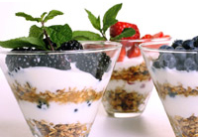
PROPER DIET Function
SURVIVAL – default function
Energy
Maintain Healthy Weight
Regulate Mood & Sleep
Disease Prevention and Control
Mental Acuity, Focus and Sharpness
Counter Effects of Stress

Slide 15
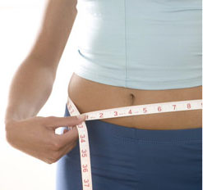
PROPER DIET Function
SURVIVAL
ENERGY
70-80% energy consumed used to keep organs functioning
Complex compensatory mechanisms
Downshifting metabolism
Converting amino acids to glycogen
Eat enough to keep all organs functioning
Carbohydrates as primary source of energy
Complex carbohydrates maintain even blood sugar levels

Slide 16
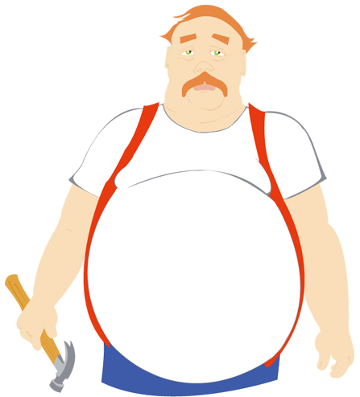
PROPER DIET Function
MAINTAIN WEIGHT
REGULATE MOOD & SLEEP
A balanced diet containing right amount of energy to fuel body and keep organs functioning will keep the body in a stable and healthy weight
Brain chemicals influence moods, energy levels, food cravings, stress levels, sleep function
What you eat affects ALL the brain chemicals in the nervous system
Ex. Depression and Mania from lack of norepinephrine and tyrosine (found in eggs, dairies and other foods)

Slide 17
PROPER DIET Function
MENTAL ACUITY, FOCUS, SHARPNESS
What you eat affects:
How you think
Your intelligence level
Your memory
Inadequate consumption of brain boosting nutrients kill brain cells
Memory loss
Reduced ability to think clearly
Poor concentration
Reduced ability to learn & reason
Lowered IQ
Less desire to learn

Slide 18
Stress, Fat and Disease
G.A.S. General Adaptation Syndrome –
3-Stage Reaction to Stress
Stage 1: Alarm Reaction – body releases adrenaline & other psychological mechanisms to combat stress & stay in control. “Fight or Flight” muscles tense, eyes dilate, heart beats faster (body returns to normal after stressor is eliminated)
Stage 2: Adaptation – long term protection, body secretes hormones that increase blood sugar levels to sustain energy & raise blood pressure. If this phase continues for a prolonged period without rest or relaxation, body collapses
Stage 3: Exhaustion – body runs out of reserve. Progressive mental, physical exhaustion , illness & death (continuous high cortisol depresses immune system)

Slide 19
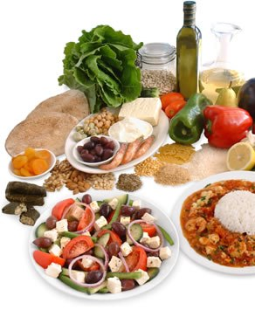
Stress, Fat and Disease
Stress & Nutrition are closely intertwined
A nutritional deficiency is stress in itself,
ex., even a slight iron deficiency reduces oxygen to tissues and brain leaving you tired, irritable & unable to concentrate
How well your body is nourished prior to and during a stressful even will affect how well you handle the stress

Slide 20
Stress and weight gain
STRESS
To conserve energy, the body downshifts metabolism, making it inefficient at burning calories and efficient at storing fat
The adrenal glands release cortisol, a stress hormone that increases blood glucose levels. Prolonged stress means chronic high blood glucose levels, which in turn encourages fat storage and insulin resistance
NPY -inhibited during acute stress but released during chronic stress to increase appetite for energy storage
Fat is packed in around the organs of the abdominal cavity - a chemical factory that secretes hormones and other substances that cause insulin resistance, inflammation and other harmful effects on metabolism, weight, and overall health.

Slide 21
Stress and Weight Gain
ESTROGEN LOSS
Cortisol is also “catabolic,” which can cause muscle tissue loss
Reduced muscle tissue means reduced metabolism, which again makes the body inefficient at burning calories and efficient at storing fat.
As the estrogen production of your ovaries falls, your body turns to secondary production sites = to FAT
Fat is valuable

Slide 22
Stress and Weight Gain
INFLAMMATION
Low Allergen diet – rapid weight loss
Following initial rapid weight loss, a person tends to lose fat more easily as well as eliminate inflammation that causes insulin resistance that also leads to weight gain
Allergies, food sensitivities, parasites, yeast overgrowth, emotional stress = inflamed GI system = taxed metabolism
Food sensitivities = gluten, wheat, dairy, soy, artificial preservatives, MSG
Stress

Slide 23
Restore health and hormonal balance BEFORE YOU TRY TO LOSE WEIGHT
Shift view away from calories toward a HOLISTIC approach
Your body is designed to defend a certain weight
To lose weight, your body has to feel safe to let go
Feeling safe means restoring balance and smooth flow of “chatter” between systems
Your body relies on it’s chemical messengers, your hormones for this chatter

Slide 24
The need for detoxification from allergens
Allergens, unhealthy bacteria, pesticides = cumulative effects of toxic exposure influence how well your body functions
WEIGHT GAIN IS A SIGN THAT DEMANDS OUTWEIGH SUPPORT
Everyone can benefit from a gentle system detox from a week long diet of additive-free foods, organic fruits and vegetables
MANY LEVELS OF CLEANSING

Slide 25
YOU CAN NOT ACHIEVE HEALTHY LEANNESS IF YOUR BODY IS CHOKED WITH DIGESTIVE, CELLULAR AND EMOTIONAL DEBRIS

Slide 26
Stress, Fat, Disease & Diet
STRESS REPAIRING NUTRIENTS
Omega 3 Fatty Acids found in fish oils & flaxseed
Green Tea (catechins)
Vitamin C found in pineapple, peppers, dalandan, kangkong, etc…
B Vitamins found in green leafy vegetables, legumes, whole grains
Glucosinolates: cruciferous vegetables such as cauliflower, bok choy, broccoli
Magnesium: tofu, pumpkin, sunflower seeds, almonds
Polyphenols: grapes, red or purple grape juice, bignay
Quercitin – cabbage, spinach, garlic

